Slide 1
MD:MAMUN
ID: 1201914 BATCH: ID-NT/ACSL-01M/R28/01

Slide 2
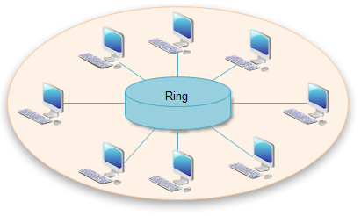
PRESENTATION OF RING TOPOLOGY

Slide 3
What does Ring Topology mean?
Ring topology refers to a specific kind of network setup in which devices are connected in a ring and pass information to or from each other according to their adjacent proximity in the ring structure. This type of topology is highly efficient and handles heavier loads better than bus topology.
A ring topology may also be called an active topology because messages are passed to each device in the ring.

Slide 4
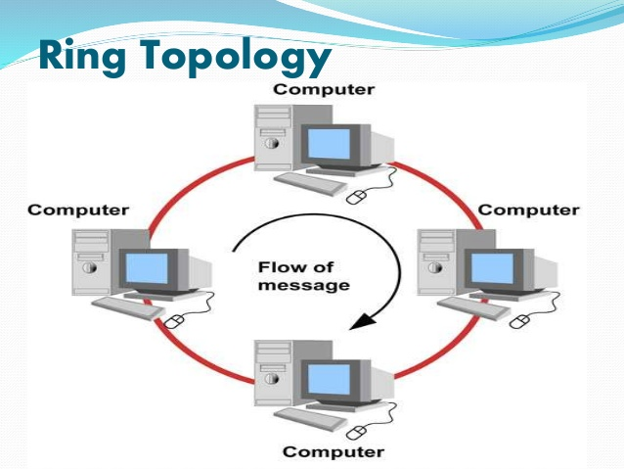
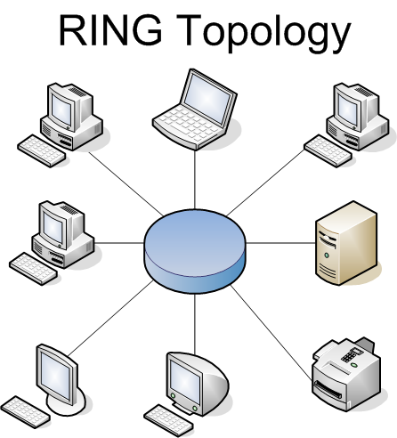

Slide 5
Advantages of ring topology
* Short cable length
* Suitable for optical fibers
Disadvantages of ring topology
* Network is reconfiguration is difficult
* Topology affects the access protocol

Slide 6
THANKS EVERYBODY………………….

